Slide 1
Computer vision and deep learning
Lecture 1

Slide 2
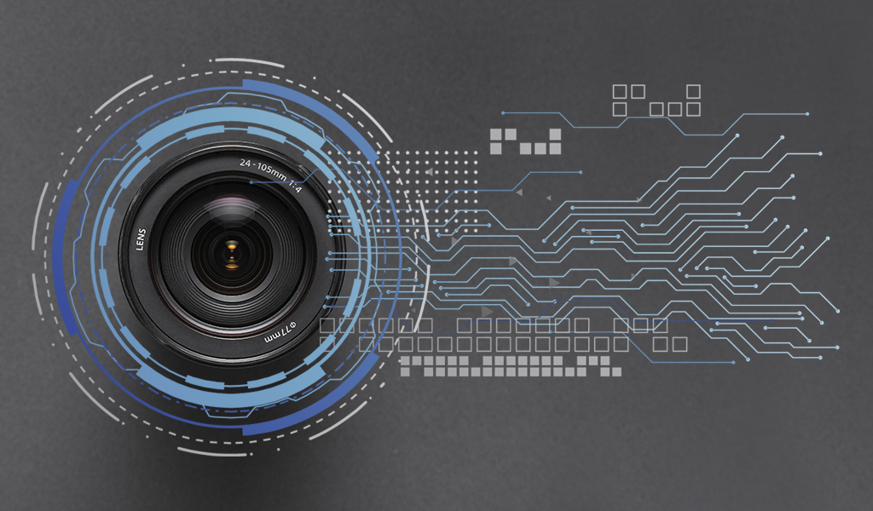
What is Computer Vision (CV)?
Goal: build computer-based vision systems which perform the same functions as the human visual system
CV builds the theoretical and algorithmic basis by which useful information about the world can be extracted and analysed from an image, a set of images (e.g. stereo vision) or an image sequence

Slide 3
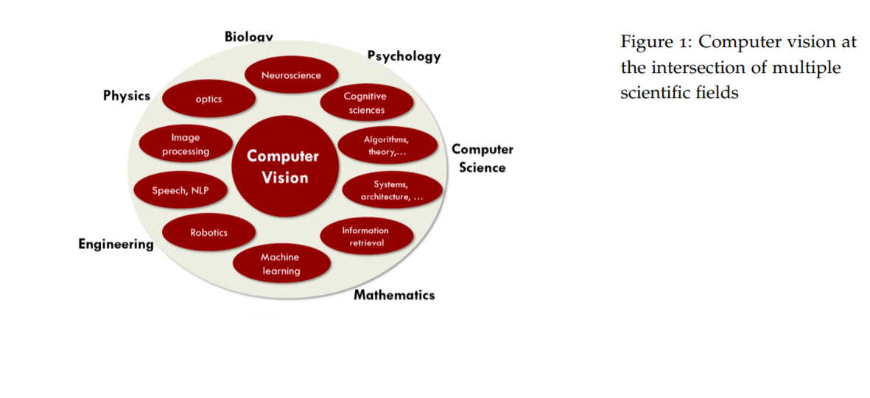
Computer vision – multidisciplinary subject
http://vision.stanford.edu/teaching/cs131_fall1718/files/cs131-class-notes.pdf

Slide 4
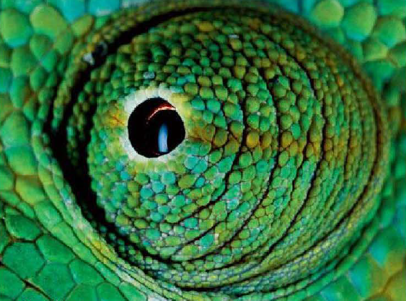
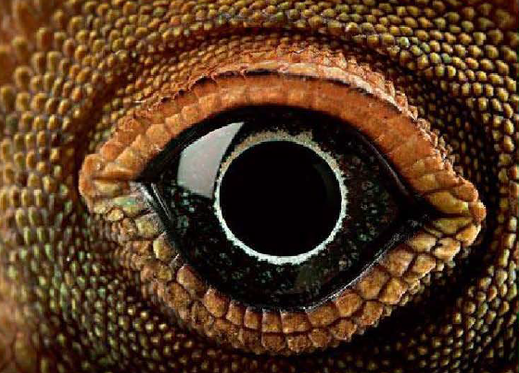
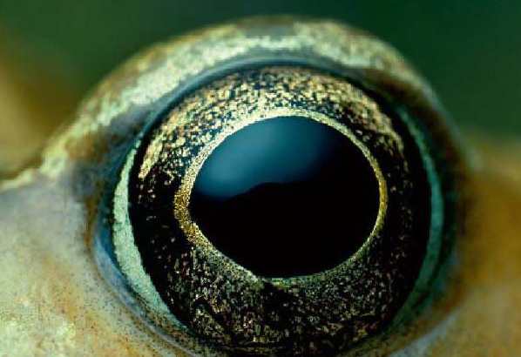
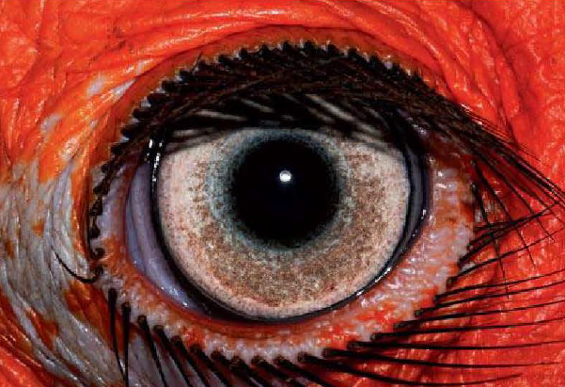
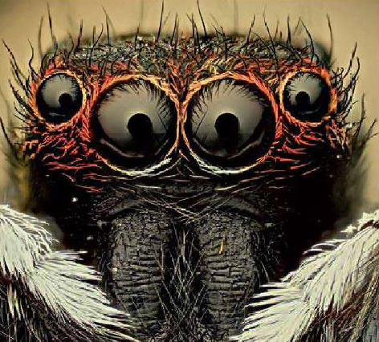
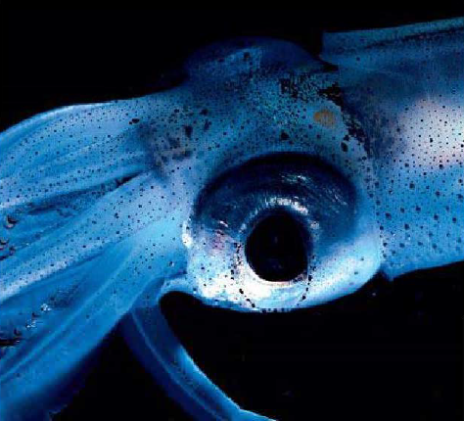
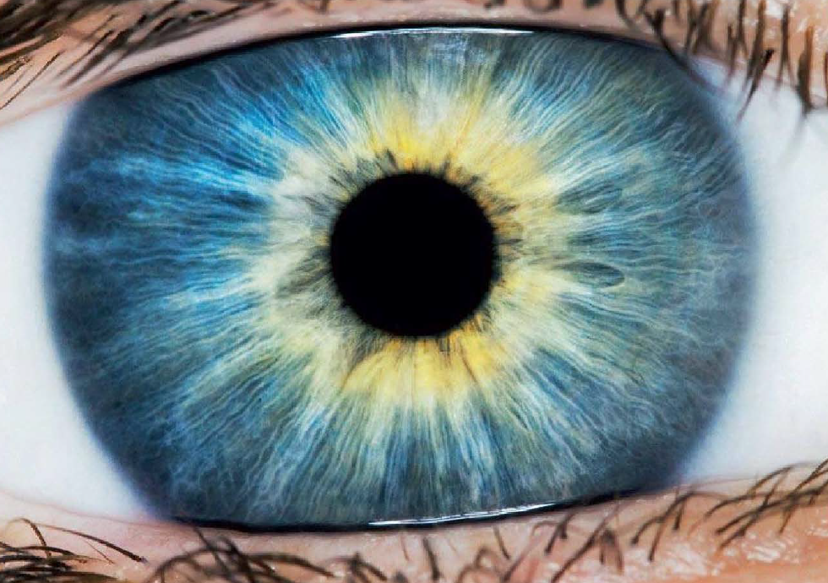
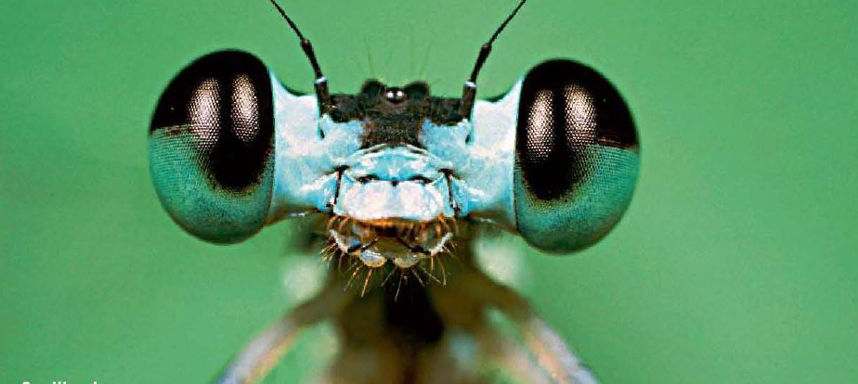
Image source: Le miracle de la vision, Christian Schwagerl, Rainer Harf et Henning Engeln

Slide 5
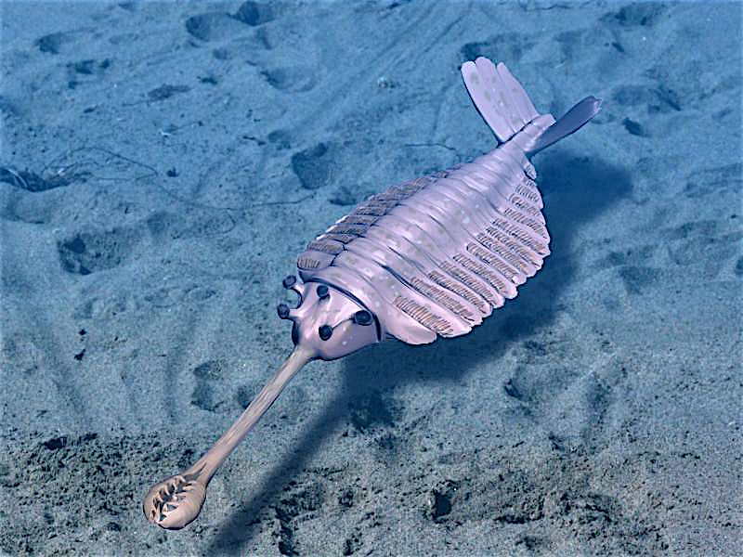
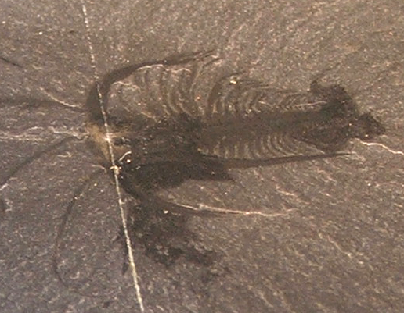
Evolution of the eye
Cambrian Explosion: 541 million years ago
Image source: https://en.wikipedia.org/wiki/Cambrian_explosion

Slide 6
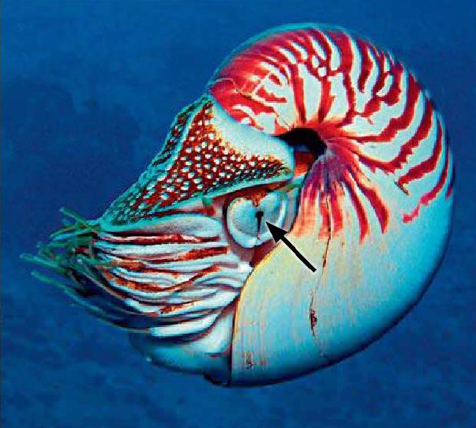
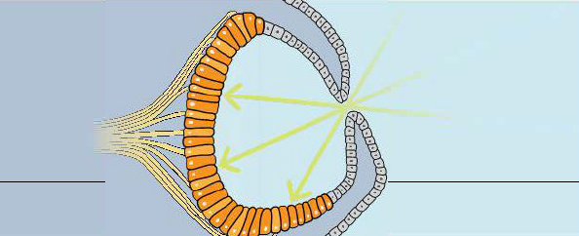
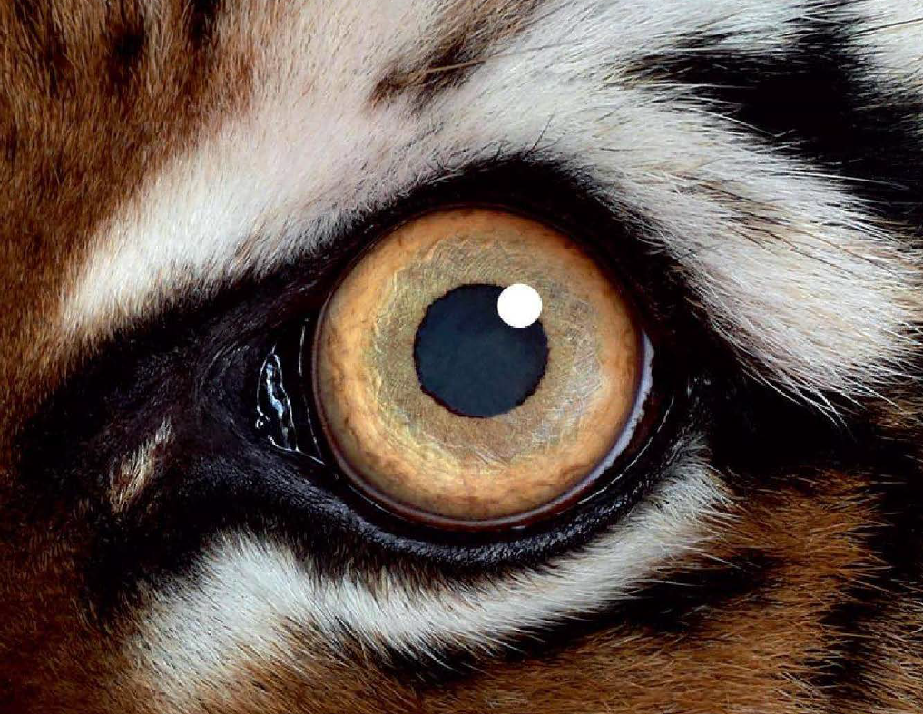
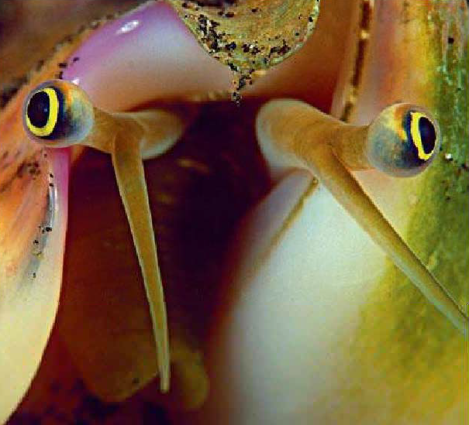
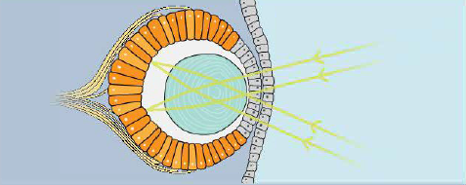
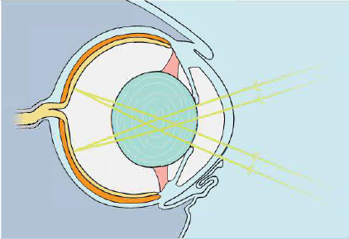
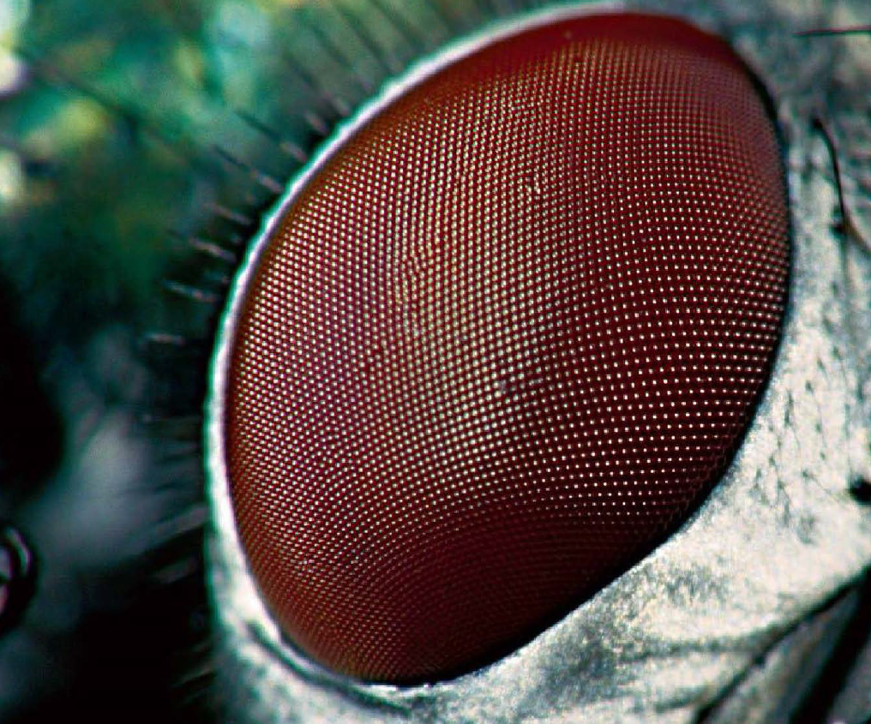
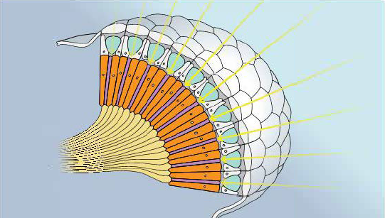

Slide 7
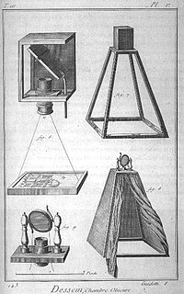
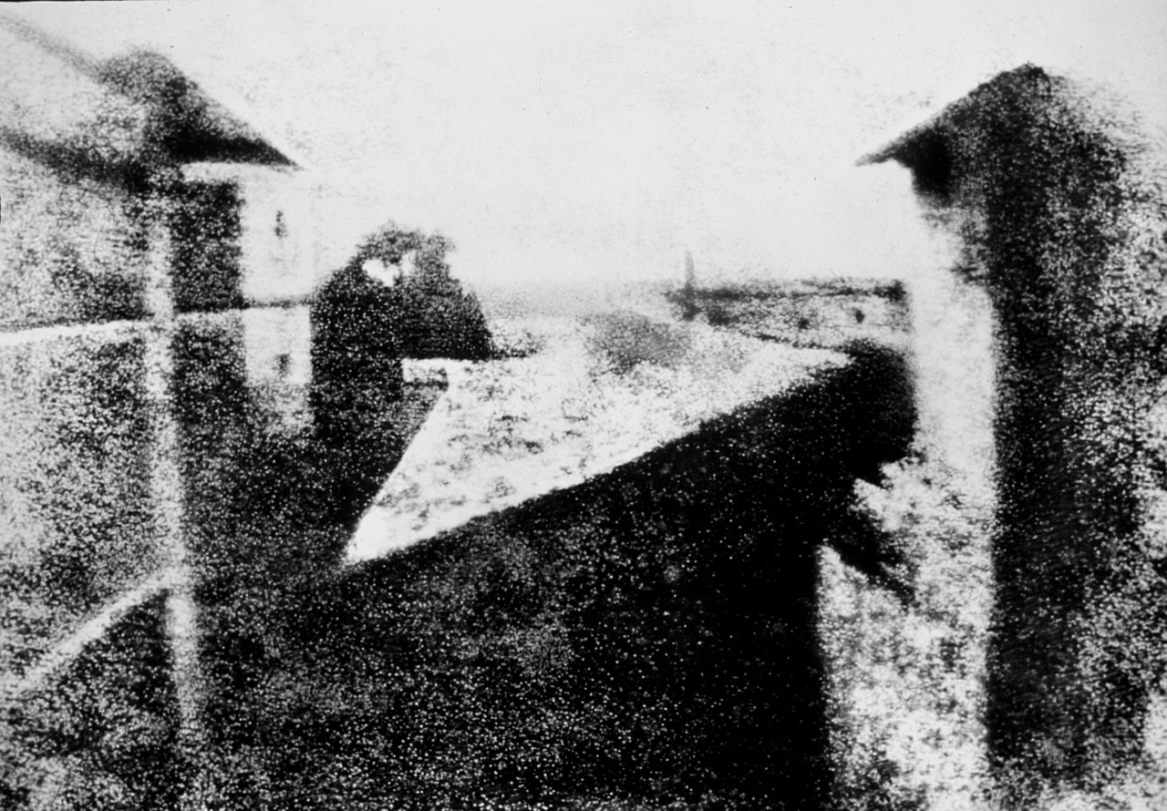
History of the camera
Chinese philosopher Mozi (470 – 391 BC) first person in history to describe the first to describe the physical principle behind the camera
Alhazen (Ibn al-Haytham) (965–1040 AD) – considered the inventor of the pinhole camera
First permanent photograph (1825) by Joseph Nicéphore Niépce (8h exposure time)
18th century description of a pinhole camera
Encyclopedia
View from the Window at Le Gras, 1827
Oldest surviving camera photograph

Slide 8
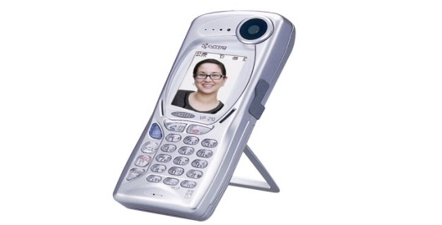
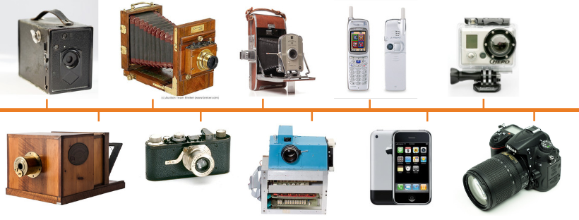
Evolution of the camera
Kyocera Visual Phone VP-210 - 1999
Image source: https://www.precisioncamerarepairs.com/blog/the-evolution-of-the-camera

Slide 9
Nowadays…
~ 1.436.300.000.000 ( > 1.4 trillion) photos will be taken in 2020 (https://focus.mylio.com/tech-today/how-many-photos-will-be-taken-in-2020 )
If you were to take all these pictures alone, and you took one pic per second = 45.544 years
As of May 2019, > 500 hours of video are uploaded to YouTube every minute! (https://www.statista.com/statistics/259477/hours-of-video-uploaded-to-youtube-every-minute/)
an estimate of 770 million surveillance cameras installed around the world today

Slide 10
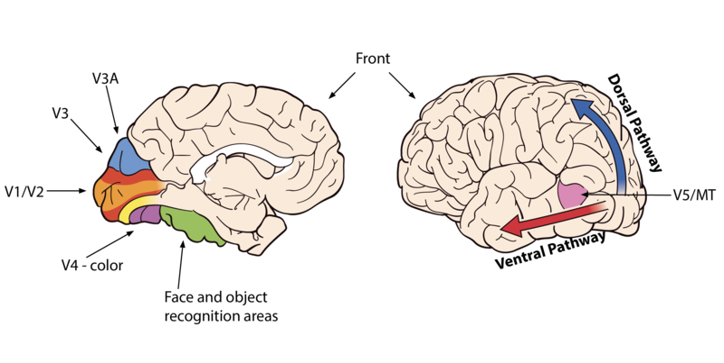
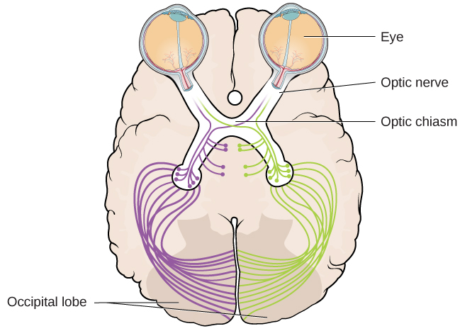
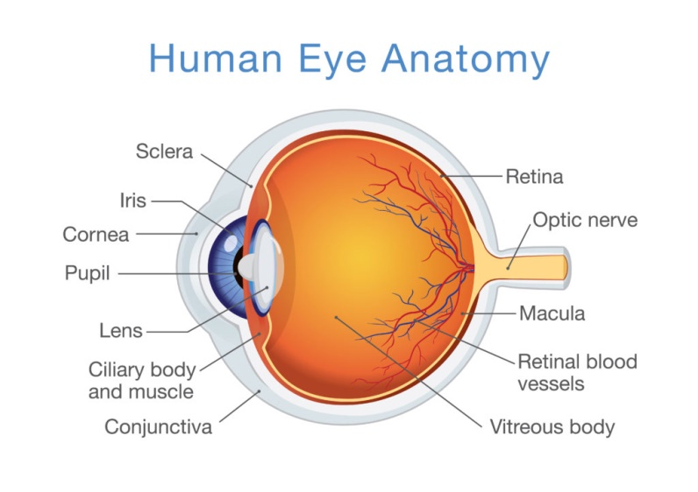
Visual cortex
Ventral pathway: “what” pathway
Dorsal pathway: “where/how” pathway
https://courses.lumenlearning.com/wmopen-psychology/chapter/outcome-vision/

Slide 11
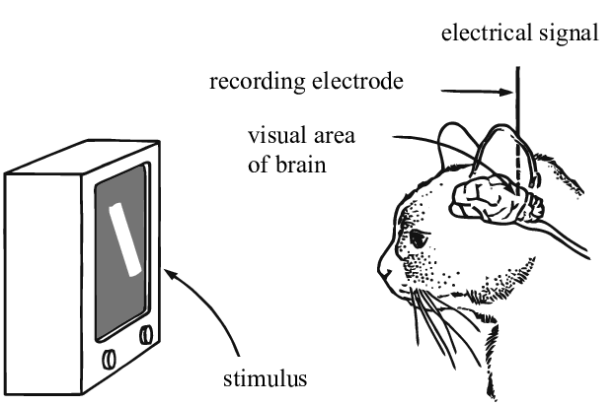
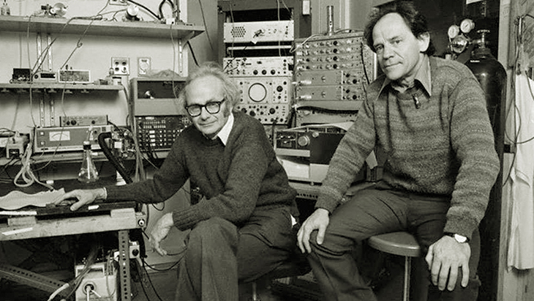
Understanding the visual cortex
Nobel Prize for Physiology or Medicine in 1981:
David Hubel and Torsten Wiesel
Simple cells:
orientation, position
Complex cells:
orientation, motion, direction
“Hypercomplex” cells:
orientation, motion, direction, length
Hubel and Wiesel, 1959
https://www.youtube.com/watch?v=IOHayh06LJ4&ab_channel=PaulLester
Image source: https://www.researchgate.net/publication/335707980_Understanding_Neural_Networks_via_Feature_Visualization_A_Survey

Slide 12
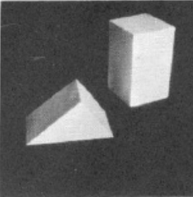
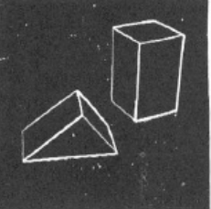
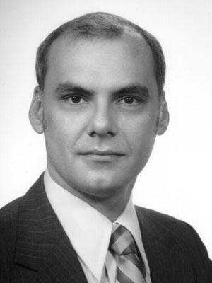
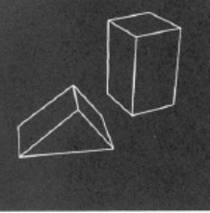
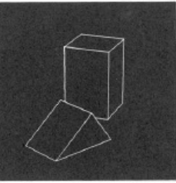
Larry Roberts
1963
First PhD thesis in the field of Computer Vision: “Machine Perception of Three Dimensional Solids”, Larry Roberts, 1963, MIT Press
extract 3D information about solid objects from 2D photographs of line drawings

Slide 13
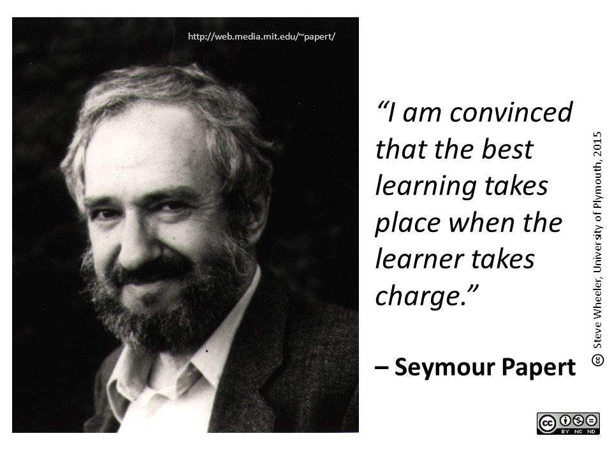
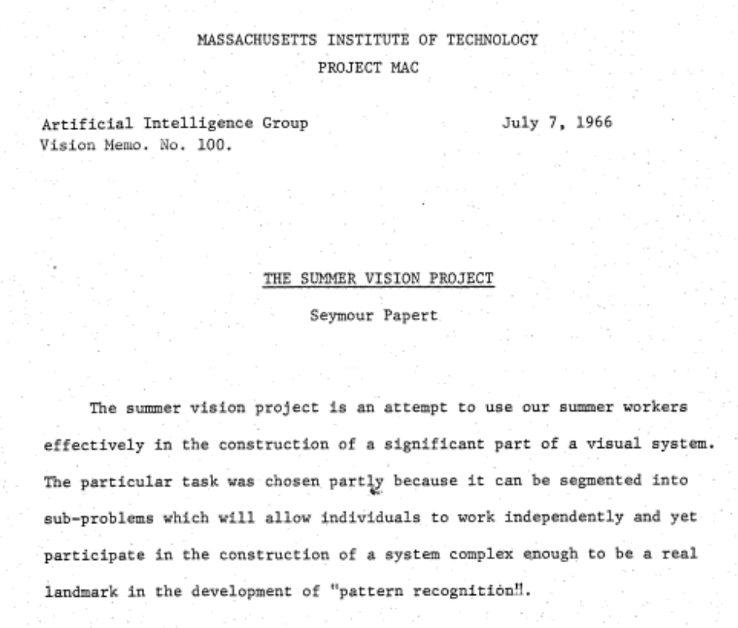
The Summer Vision Project
1966
The primary goal of the project is to construct a system of programs which will divide a vidisector picture into regions such as likely objects, likely background areas and chaos. We shall call this part of its operation FIGURE-GROUND analysis. It will be impossible to do this without considerable analysis of shape and surface properties, so FIGURE-GROUND analysis is really inseparable in practice from the second goal which is REGION DESCRIPTION. The final goal is OBJECT IDENTIFICATION which will actually name objects by matching them with a vocabulary of known objects.

Slide 14
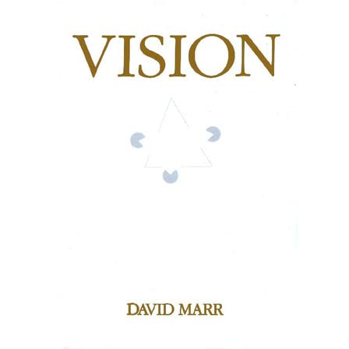
David Maar
1981
Scene
Image
Pixel intensities
Primal sketch
Edges, blobs, curves boundaries
2.5 Surface Map
2.5D Symbolic map
Depth image, surface orientations
Relational Structure
Object centred coordinate system (surface and geometrical primitives)
Recognition description

Slide 15
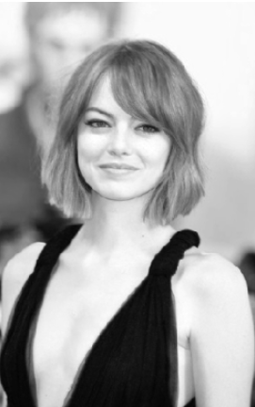
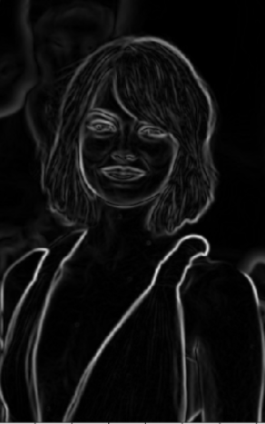
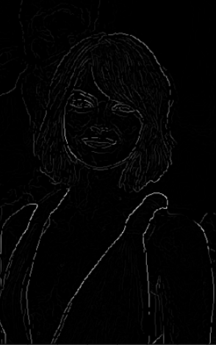
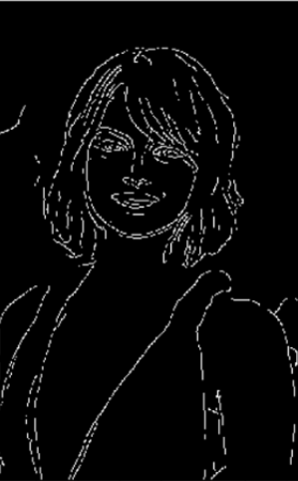
Canny edge detector
1986
Images from https://towardsdatascience.com/canny-edge-detection-step-by-step-in-python-computer-vision-b49c3a2d8123

Slide 16
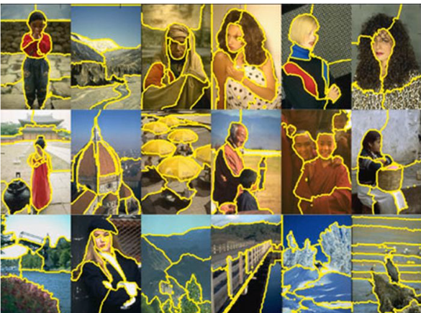
Normalized Cuts and Image Segmentation Jianbo Shi and Jitendra Malik
1997

Slide 17
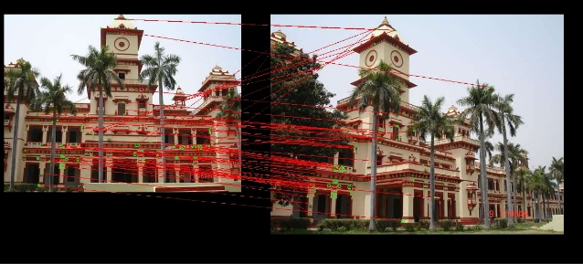
Scale Invariant Feature Transform David G. Lowe
1999
Local image features invariant to image scaling, translation, and rotation, and partially invariant to illumination changes and affine or 3D projection

Slide 18
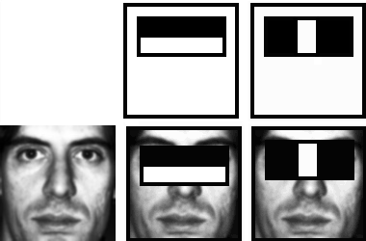
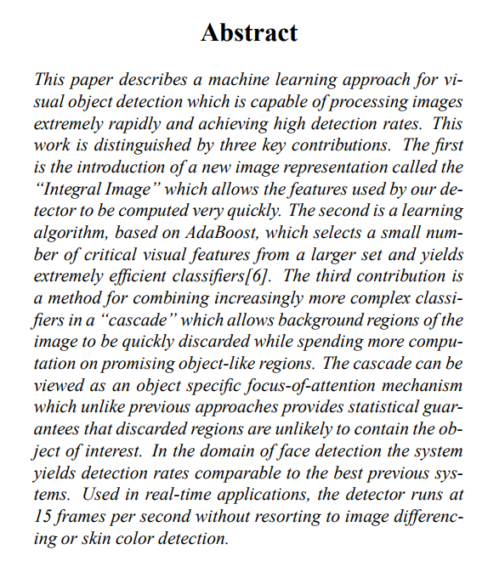
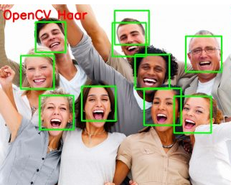
Rapid object detection using a boosted cascade of simple features Paul Viola and Michael Jones
2001

Slide 19
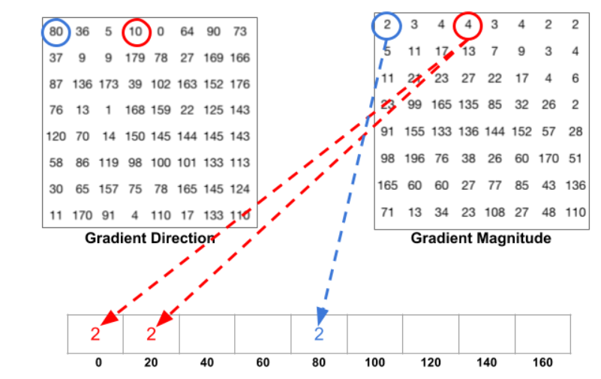
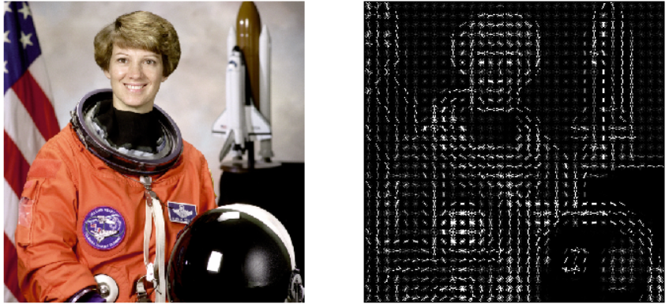
Histogram of Oriented Gradients Navneet Dalal and Bill Triggs
2005
Image source: https://iq.opengenus.org/object-detection-with-histogram-of-oriented-gradients-hog/

Slide 20
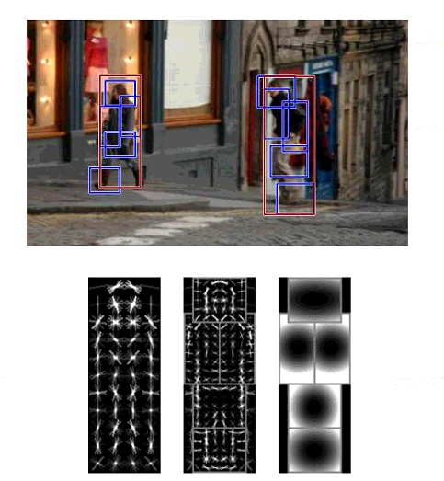
Deformable part models P. Felzenszwalb,R. Girshick, D. McAllester, D. Ramanan
2009

Slide 21
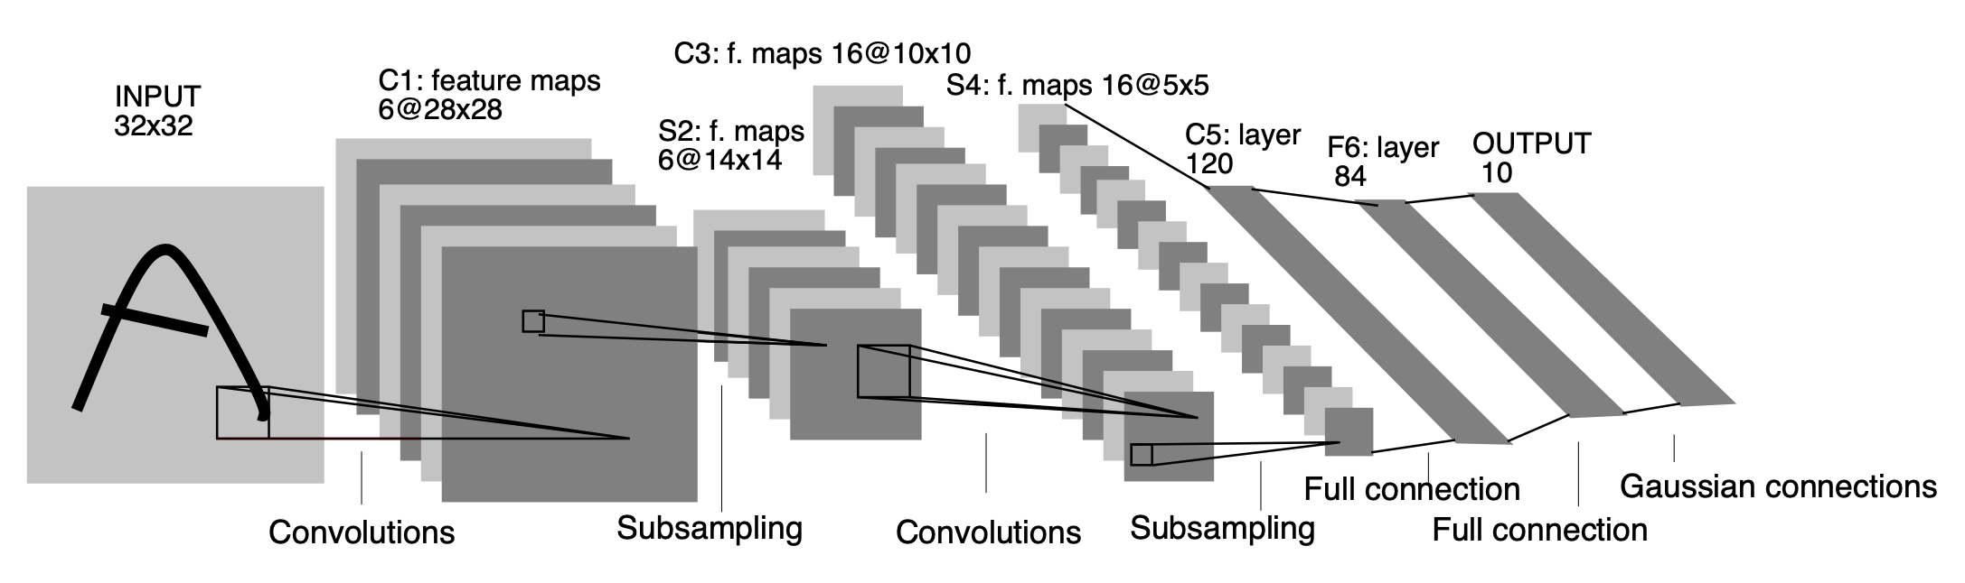

2012
LeNet (1998)
AlexNet (2012)

Slide 22

Visual transformers
2021
https://arxiv.org/abs/2010.11929

Slide 23

Data

Slide 24

Caltech 101
2003
9,146 images, split between 101 distinct object categories and a background category
40 to 800 images per category

Slide 25

Pascal VOC
2007
9,963 images containing 24,640 object split into 20 classes:
airplane, bicycle, boat, bottle, bus, car, cat, chair, cow, dining table, dog, horse, motorbike, person, potted plant, sheep, train, TV

Slide 26


ImageNet
2010
> 14 million images organized into over 20,000 categories
organized according to the WordNet hierarchy (nouns), in which each node of the hierarchy is depicted by hundreds and thousands of images

Slide 27


JFT
2017
internal dataset used by Google to train image classification algorithms
the dataset has 300M images and 375M labels (multiple labels per image, on average each image has 1.26 labels)
noisy labels: no human processing is involved
labeled using an algorithm that uses complex mixture of raw web signals, connections between webpages and user feedback
https://arxiv.org/pdf/1707.02968v2.pdf

Slide 28

Computer vision - Where are we now?
human
Image source: https://towardsdatascience.com/review-senet-squeeze-and-excitation-network-winner-of-ilsvrc-2017-image-classification-a887b98b2883

Slide 29

ImageNet accuracy

Slide 30




Computer vision applications I
Penguin
Penguin
Classification
Object Detection
Semantic segmentation
Instance segmentation

Slide 31



Computer vision applications II
Image captioning
Style transfer
Action recognition

Slide 32



Computer vision applications III
Image generation
https://thispersondoesnotexist.com/
https://thiscatdoesnotexist.com/
https://edition.cnn.com/2020/02/28/tech/fake-twitter-candidate-2020/index.html

Slide 33


Computer vision applications IV
Image translation
Talking head models

Slide 34



Computer vision surpassed human vision
Captcha recognition
Face recognition
Object recognition

Slide 35

“We should all be playing games and let AI do all the work, instead AI plays games and we do all the work”
Andrej Karpathy

Slide 36

Computer vision vs. human vision
Example from Andrej Karpathy’s blog: http://karpathy.github.io/2012/10/22/state-of-computer-vision/

Slide 37


Stanford AI index 2021
Globally, investment in AI start-ups: from a total of $1.3B raised in 2010 to over $40.4B in 2018 (with $37.4B in 2019 as of November 4th), funding has increased at an average annual growth rate of over 48%
Industry has become, by far, the largest consumer of AI talent. 65% of graduating North American PhDs in AI went into industry—up from 44.4% in 2010.
AI investment in drug design and discovery increased significantly
https://aiindex.stanford.edu/report/

Slide 38


CVPR 2019
Topics distribution
Number of attendees

Slide 39





Start-ups developing Computer Vision
OrCAM: Wearable device, for people who are blind or visually impaired, that reads text, recognizes faces, identifies products & more
Pixee Medical has created the first computer-assisted orthopaedic surgery solution using augmented reality to support total knee arthroplasty.
Ceres Imaging combines high-resolution aerial imagery with advanced analytics to help farms, orchards, and vineyards optimize irrigation strategy and performance
Valuable property attributes combined with a simple API allow investors and insurers to better select properties, evaluate risk, and streamline underwriting processes.
" Out-of-stocks" detection - FocalSystems
https://www.forbes.com/sites/robtoews/2021/02/28/a-wave-of-billion-dollar-computer-vision-startups-is-coming/?sh=21ce139b3f4c

Slide 40
Course overview
Part 1: Fundamentals. Artificial Neural Networks
Multi layer perceptron
Optimization. Loss functions
Neural Networks
Part 2: Convolutional neural networks and visual transformers
Convolutions. Convolutional layers. Pooling layers.
Recurrent neural networks
Visual transformers
Part 3: Applications and case studies
Object detection
Segmentation. Instance segmentation
Style transfer. Image generation
Visualizing and understating

Slide 41
Laboratories
Introduction to python, numpy. Getting to know each other.
Implement a softmax classifier (from scratch). Evaluating a model.
Implement a neural network in keras. Hyperparameter tunning.
Convolutional neural networks, transfer learning, fine tuning.
5. Segmentation, some advanced keras features.
6. Recurrent neural networks, visual transformer.
7. Neural network visualization techniques.

Slide 42
Projects
Work in teams: 2-4 students
From week 6, individual meetings with each team.
Deadlines
Week 3: project proposal
Week 6: state of the art, find datasets to train and test on, (maybe) run some of the state of the art works and analyse their results
Week 9: bring your own contribution!
Week 12: improve your first solution, more experiments, documentation
Week 14 (lecture): have our own CV conference. 3 min teaser presentations, vote for the best projects
Documentation: https://www.overleaf.com/latex/templates/cvpr-2018-template/qgmrfntfbqns
Useful tips (Zachary Lipton): https://www.approximatelycorrect.com/2018/01/29/heuristics-technical-scientific-writing-machine-learning-perspective/

Slide 43
Course logistics
Online lectures:
Microsoft Teams
Build a virtual community among the students
Channels:
Funny stuff
Research articles
Lab questions
General announcements

Slide 44
Grading
Written examination: 40%
Project and lab: 60 %
The final grade (average between written exam and project) should be at least 5

Slide 45
Recommended resources
Goodfellow, Ian, Yoshua Bengio, and Aaron Courville. Deep learning. MIT press, 2016.
http://www.deeplearningbook.org/
Langr, Jakub, and Vladimir Bok. GANs in Action. (2018)
deeplearning.ai
https://www.deeplearning.ai/

Slide 46
I hope you’ll enjoy this course ☺

